Slide 1

CMPE 280 – Project Team J2D VDO Chat Application
Members:
Jay Patel ID: 015216357
Janmejay Bhavsar ID: 015931344
Dhanush Babu ID: 015923882

Slide 2
Overview
Login or Sign up if you’re not already registered
Select a customized Chat ID/Alias for chatting with others
Choose to turn ‘on’ or ‘off’ your video and audio
Chat with other users on the chat window with your Chat ID
Query the ChatBot with “@ChatGPT”
Share your screen with all other users in the call

Slide 3
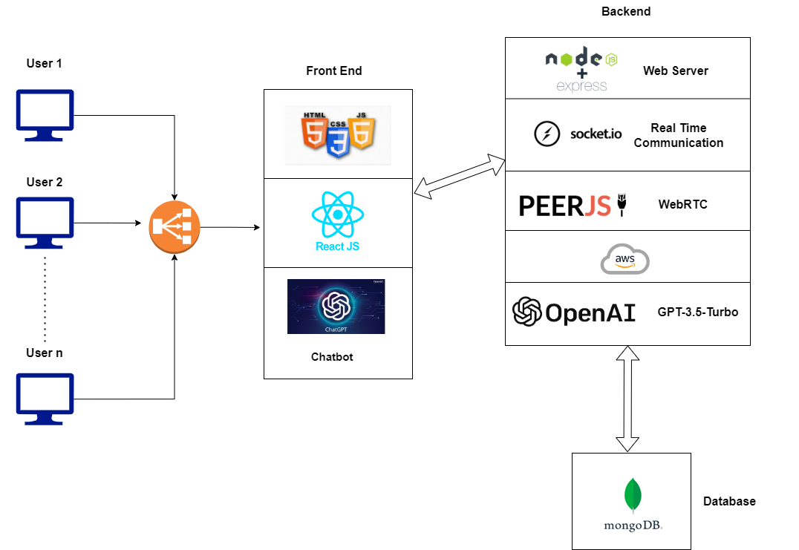
System Architecture
Notes:
ExpressJS
Why use ExpressJS instead of NodeJS?
ExpressJS is a web application framework for NodeJS. That's what mainly makes the difference between Express JS and Node JS. Ejs provides various features that make web application development fast and easy, which otherwise takes more time using nodejs. Used it bc it ensures uniformity b/w front and backend and easier to connect db and is async.
Socket.io/RTC
The code uses the PeerJS library, which simplifies WebRTC peer-to-peer connections. It sets up a PeerJS server endpoint at /peerjs and integrates it with the Express app. The PeerJS server handles WebRTC signaling and establishes peer connections between clients. It initializes and configures a Socket.IO client to connect to the server using the io function.
PeerJS/WebRTC
WebRTC (Web Real-Time Communication) is used in the provided code to enable real-time audio, video, and data communication between clients (web browsers) in a peer-to-peer manner.
The code uses the PeerJS library, which simplifies WebRTC peer-to-peer connections. It sets up a PeerJS server endpoint at /peerjs and integrates it with the Express app. The PeerJS server handles WebRTC signaling and establishes peer connections between clients.
OpenAI
Integrated a chatbot powered by OpenAI's GPT-3 language model.

Slide 4
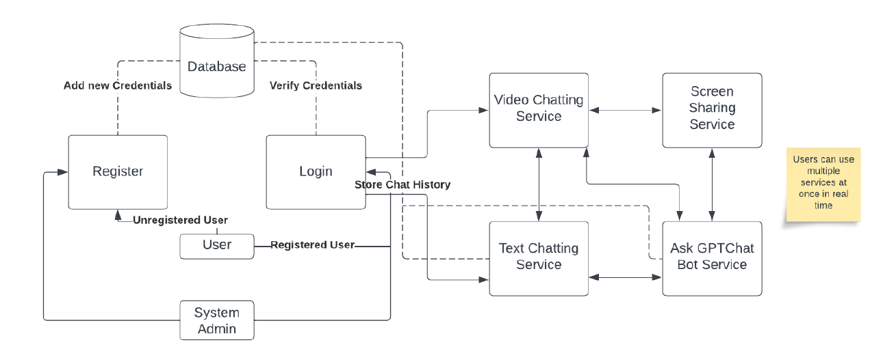
Data Flow Diagram

Slide 5
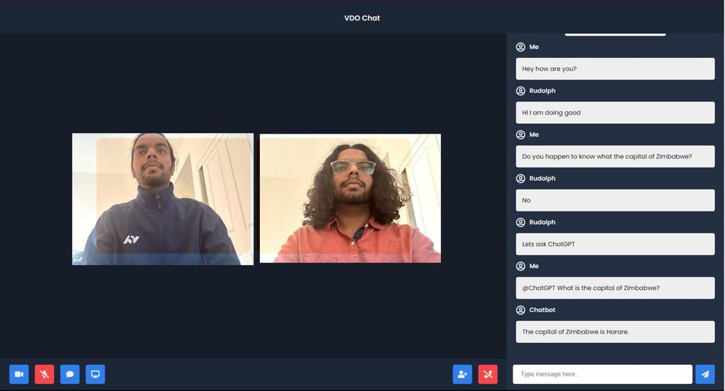
Multiple users

Slide 6
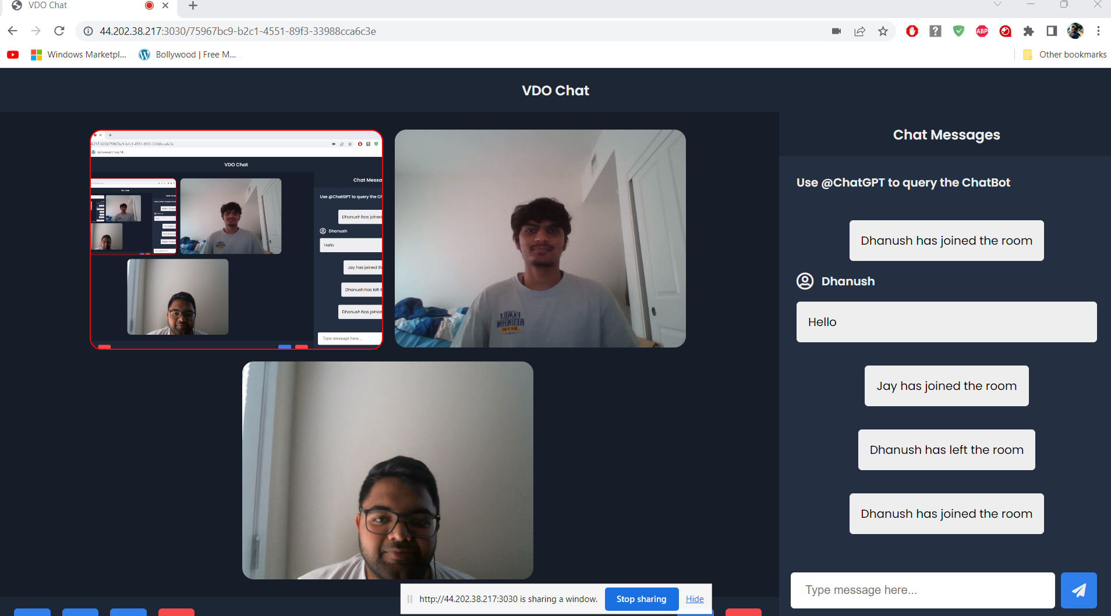
Screensharing

Slide 7
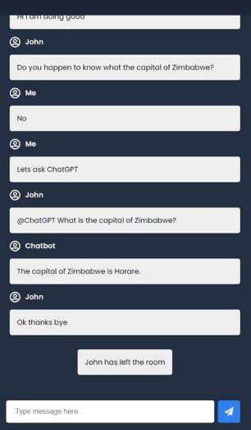



Querying the Chat Bot

Slide 8
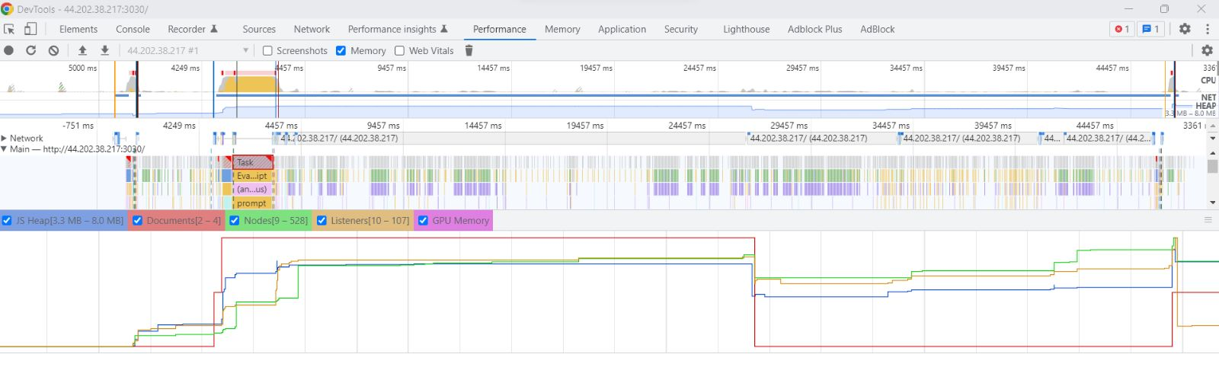
Profiling

Slide 9
Any Questions?
Thank You

